Slide 1
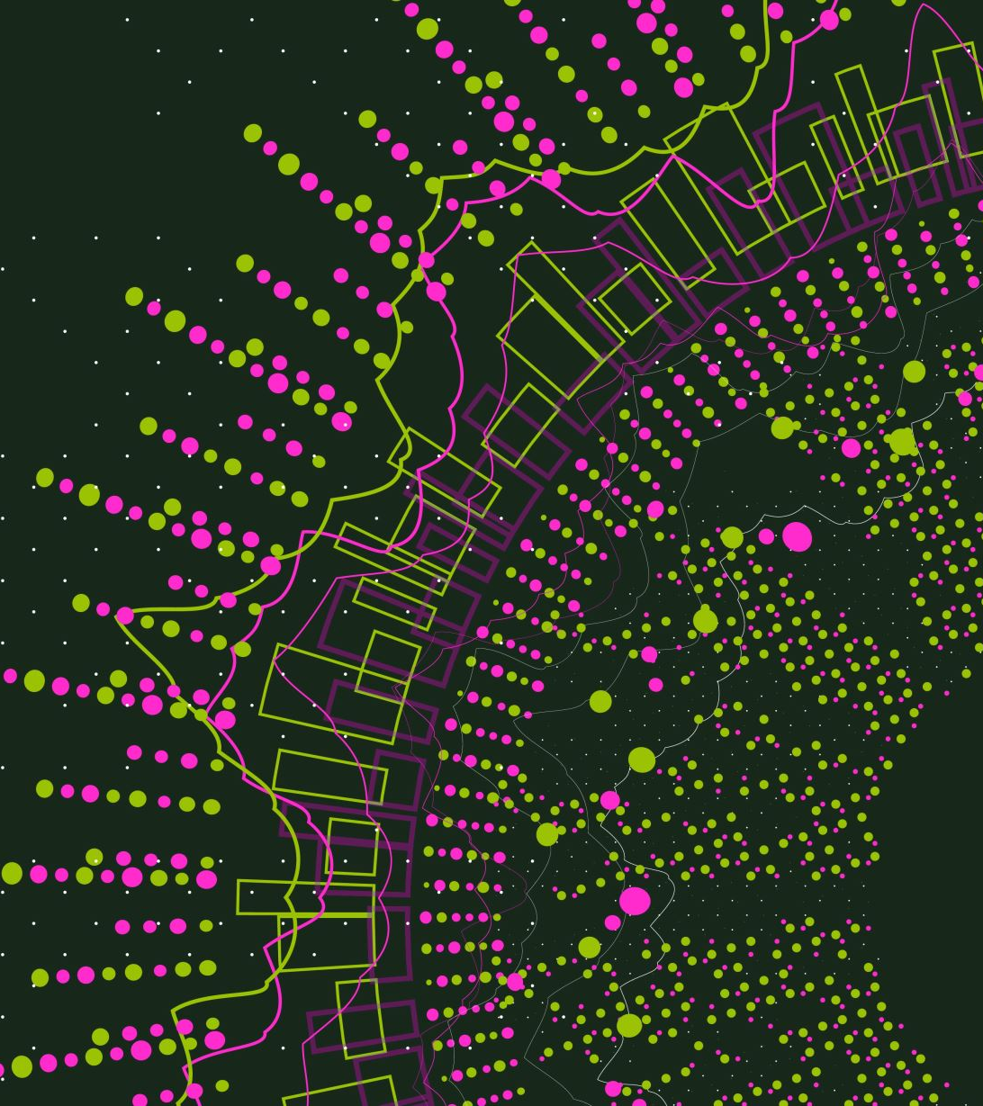
Interface Builder
Week3
2022/3/9

Slide 2

Last week we have created our first “doing nothing” app,
this week we would like to make a little change…

Slide 3
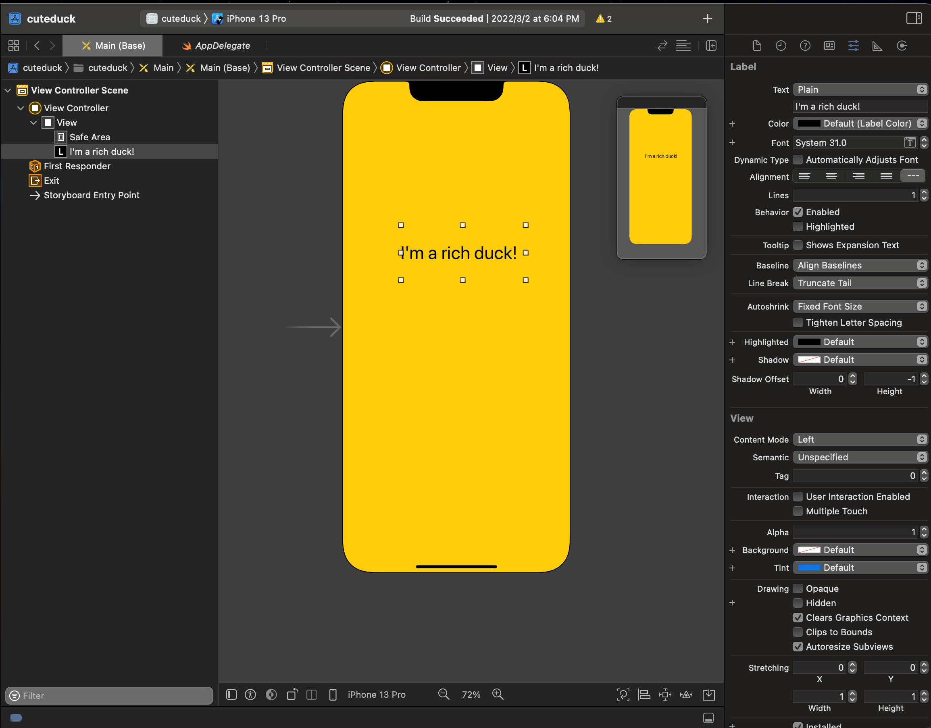
Attribute Inspector
Remember, if we want to change something in the interface, we first must select the item and then we must go into the attribute inspector, which is denoted by the symbol showing in the figure.
Attribute Inspector

Slide 4
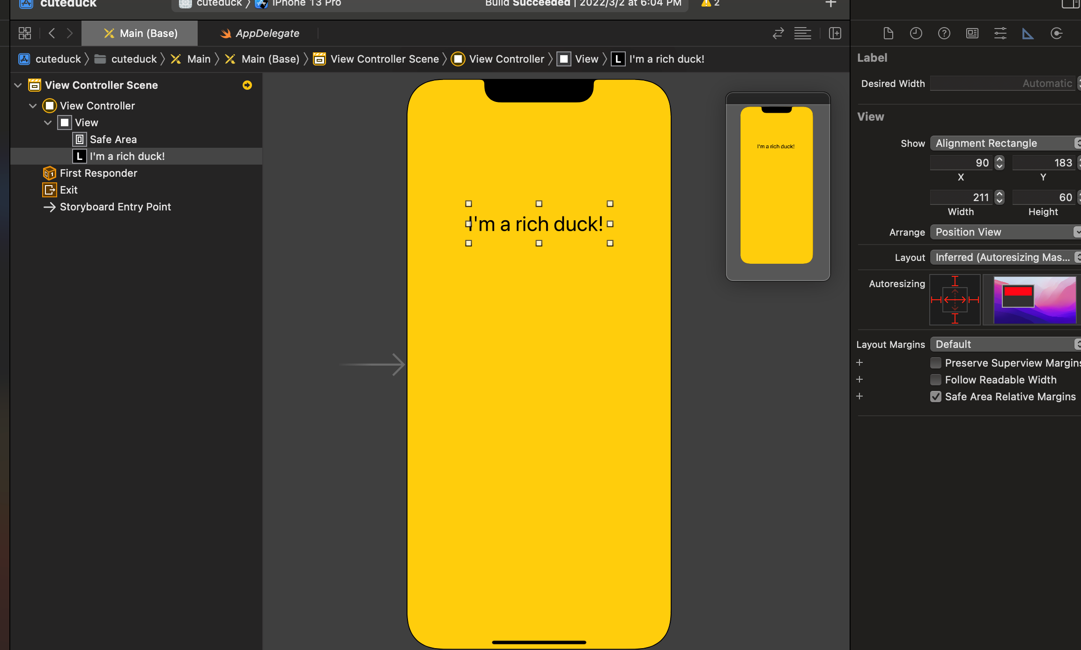
Size Inspector
Size Inspector

Slide 5
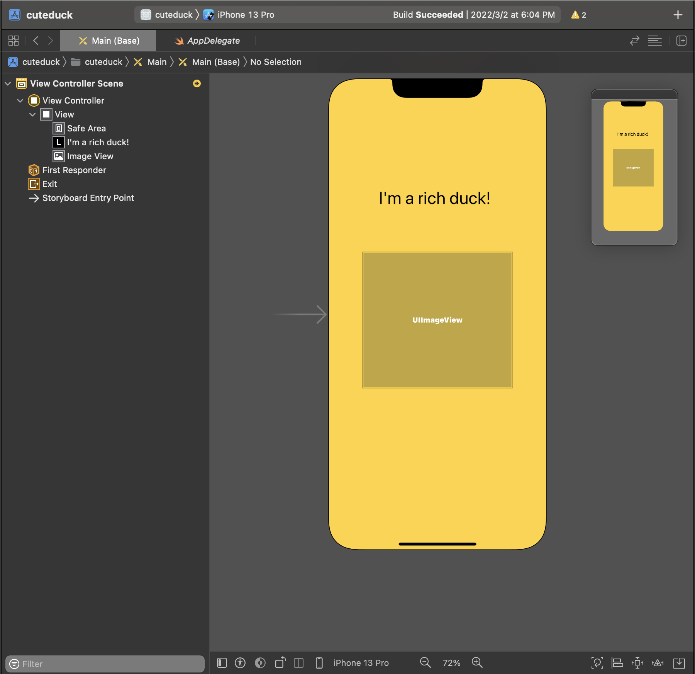
Challenge
Now let's add a new object UIImageView in the interface(view)

Slide 6
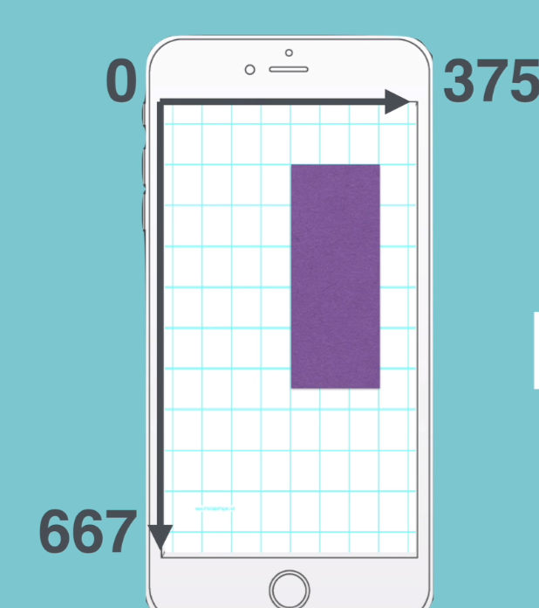
Positioning UI Element
You can imagine the iPhone screen as a graph where the top left corner is zero or the origin of the graph,
and where the x axis runs along the horizontal edge of the phone and the Y axis corresponds to the vertical edge.

Slide 7
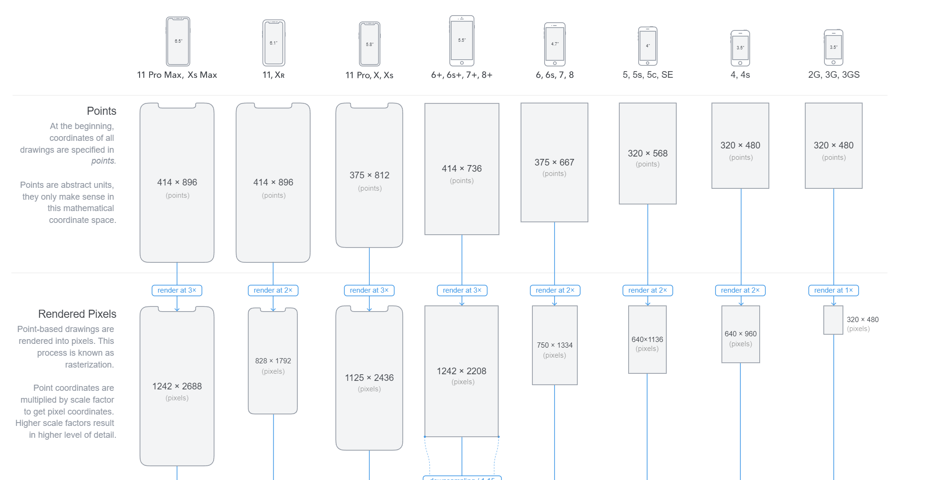
The Ultimate Guide To iPhone Resolutions
You can find the guide to resolutions from this website: https://www.paintcodeapp.com/news/ultimate-guide-to-iphone-resolutions

Slide 8
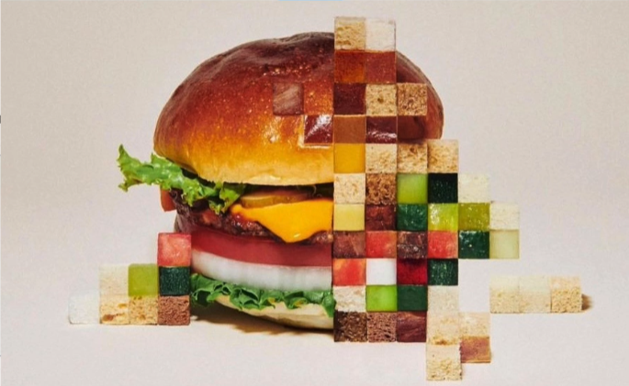
Point and Resolution

Slide 9
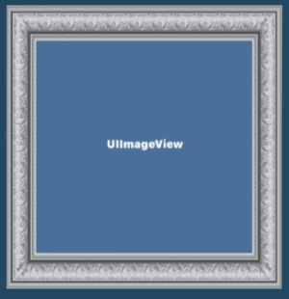
Image View
An Image View is simply a picture frame where you can put images into it.
But where can we get the image?

Slide 10
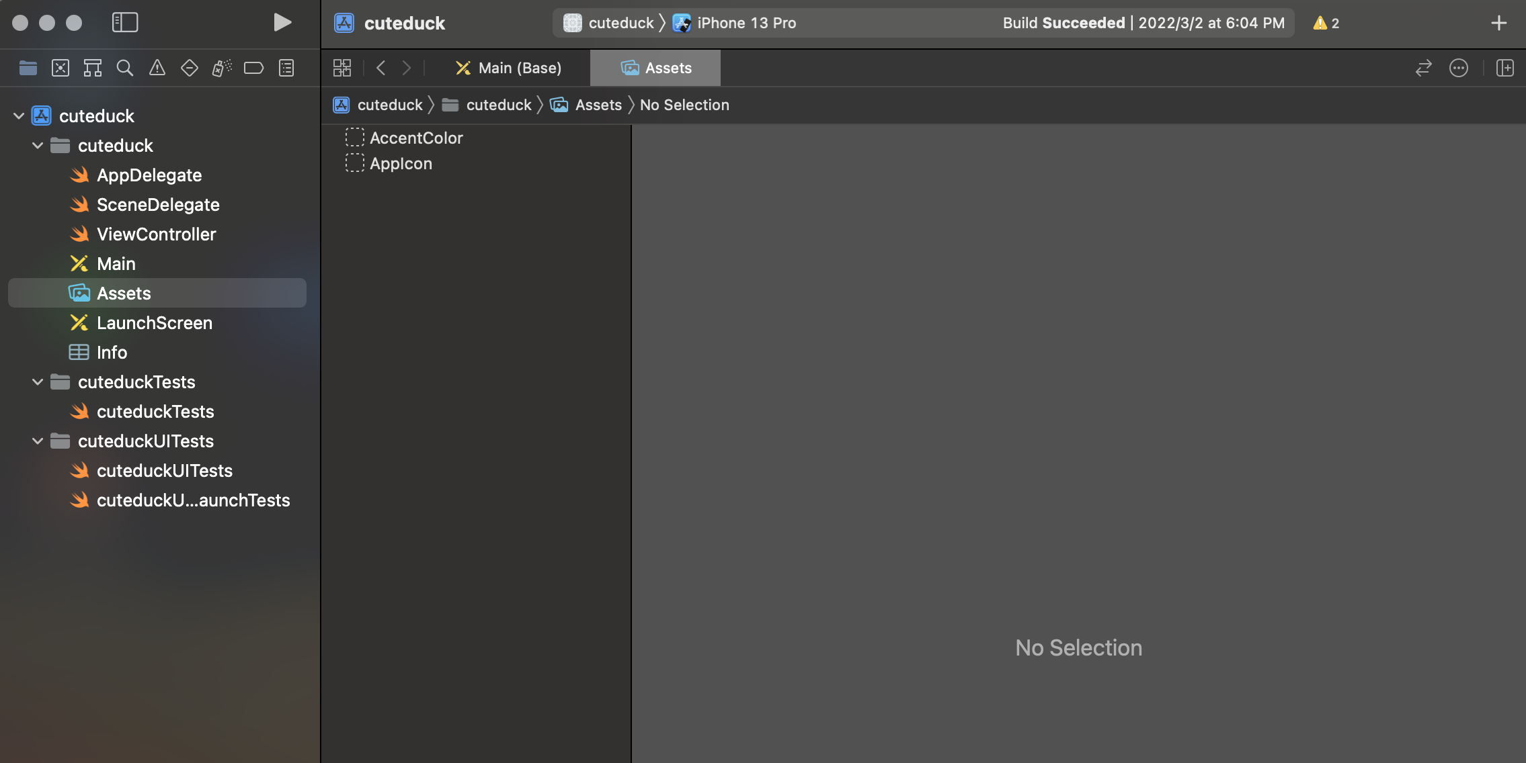
Assets.xcodeassets
If you look over in the navigator pane, you can see that we've got a folder called Assets.xcodeassets.
After you click on it, you can see that it's completely blank now.

Slide 11
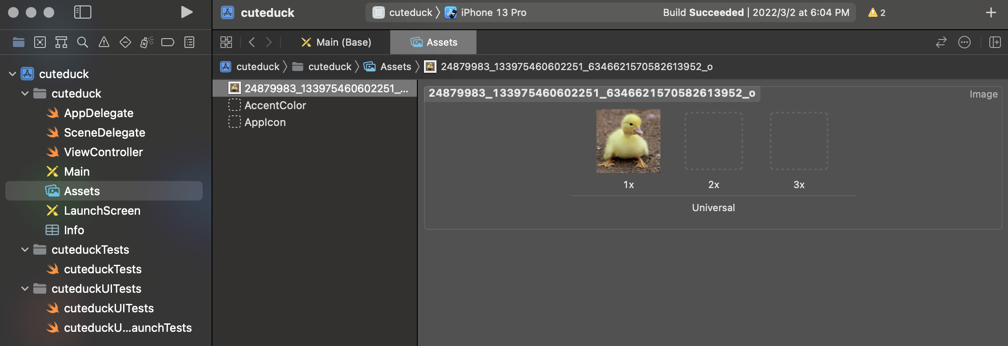
Put Image into The Assets
1.Please download the Diamond_Asset.zip file from the E-Learning
2.Unzip the zip file and drop the diamond.png to the assets
3.You can use your own image whatever

Slide 12
Universal
Now notice how as soon as you put the image into the assets, it was dropped in at the 1x position.
What does that mean? What does it mean when it says 1x, 2x, and 3x?

Slide 13


Retina
If we have a picture here of the settings icon in the app in iOS.
Now if I had blown that up to a gigantic size, then you can see that it's super pixilated and it's not very clear at all.
So how can we make things look sharp on a screen?

Slide 14
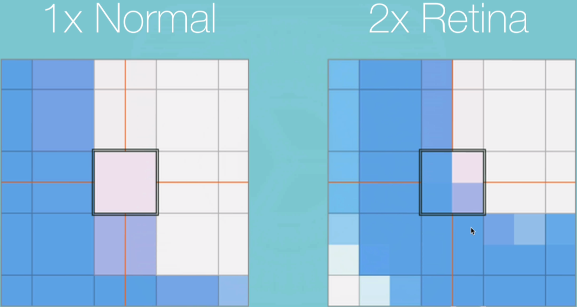
Retina

Slide 15
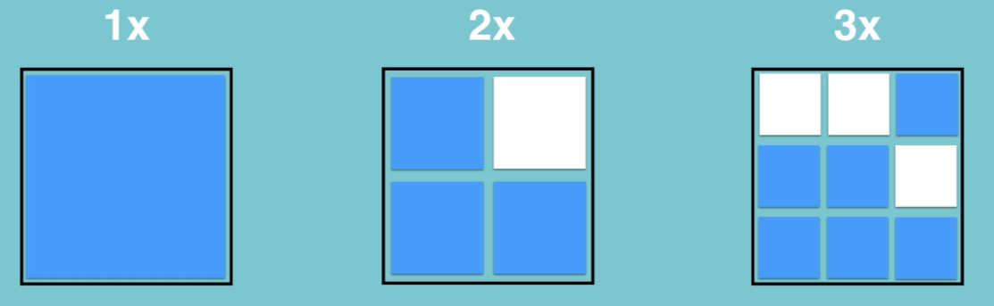
Retina

Slide 16
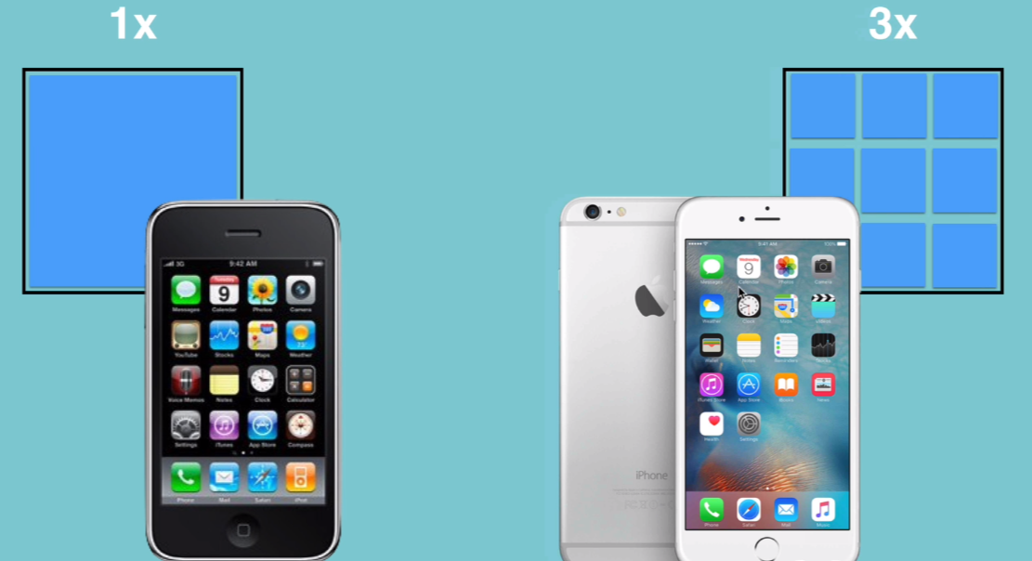
Retina

Slide 17
Retina
Let’s think back to this 1x, 2x. and 3x images, the 3x image is three times as large as the 1x, and the 2x is 2 times as large.
But if you have an image that's three times as large that's then shrunken to a third of its size, then it's obviously going to have smaller pixels and it's going to be sharper.

Slide 18

How to Get These Images?
When you're creating assets for your app, you can either do this manually or if you're using software such as sketch or illustrator, then you have existing tools that allow you to export images in their 1x, 2x, and 3x sizes.
Now what if you don't have sketch or illustrator and you're not familiar with design software?
Well, the simplest way of generating image assets is to simply use an online tool called App Icon Generator and you can go to appicon.co to use it.

Slide 19
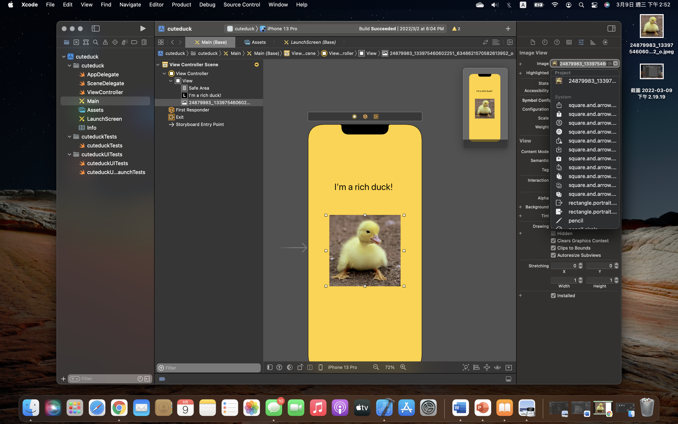
Select The Image
We're now finally ready to use these assets. If we head back over to the Main.storyboard, we can select our image view again. And here, when we get to select the image in the image view.
We can click the dropdown and see that we've got the image that comes from our project.

Slide 20
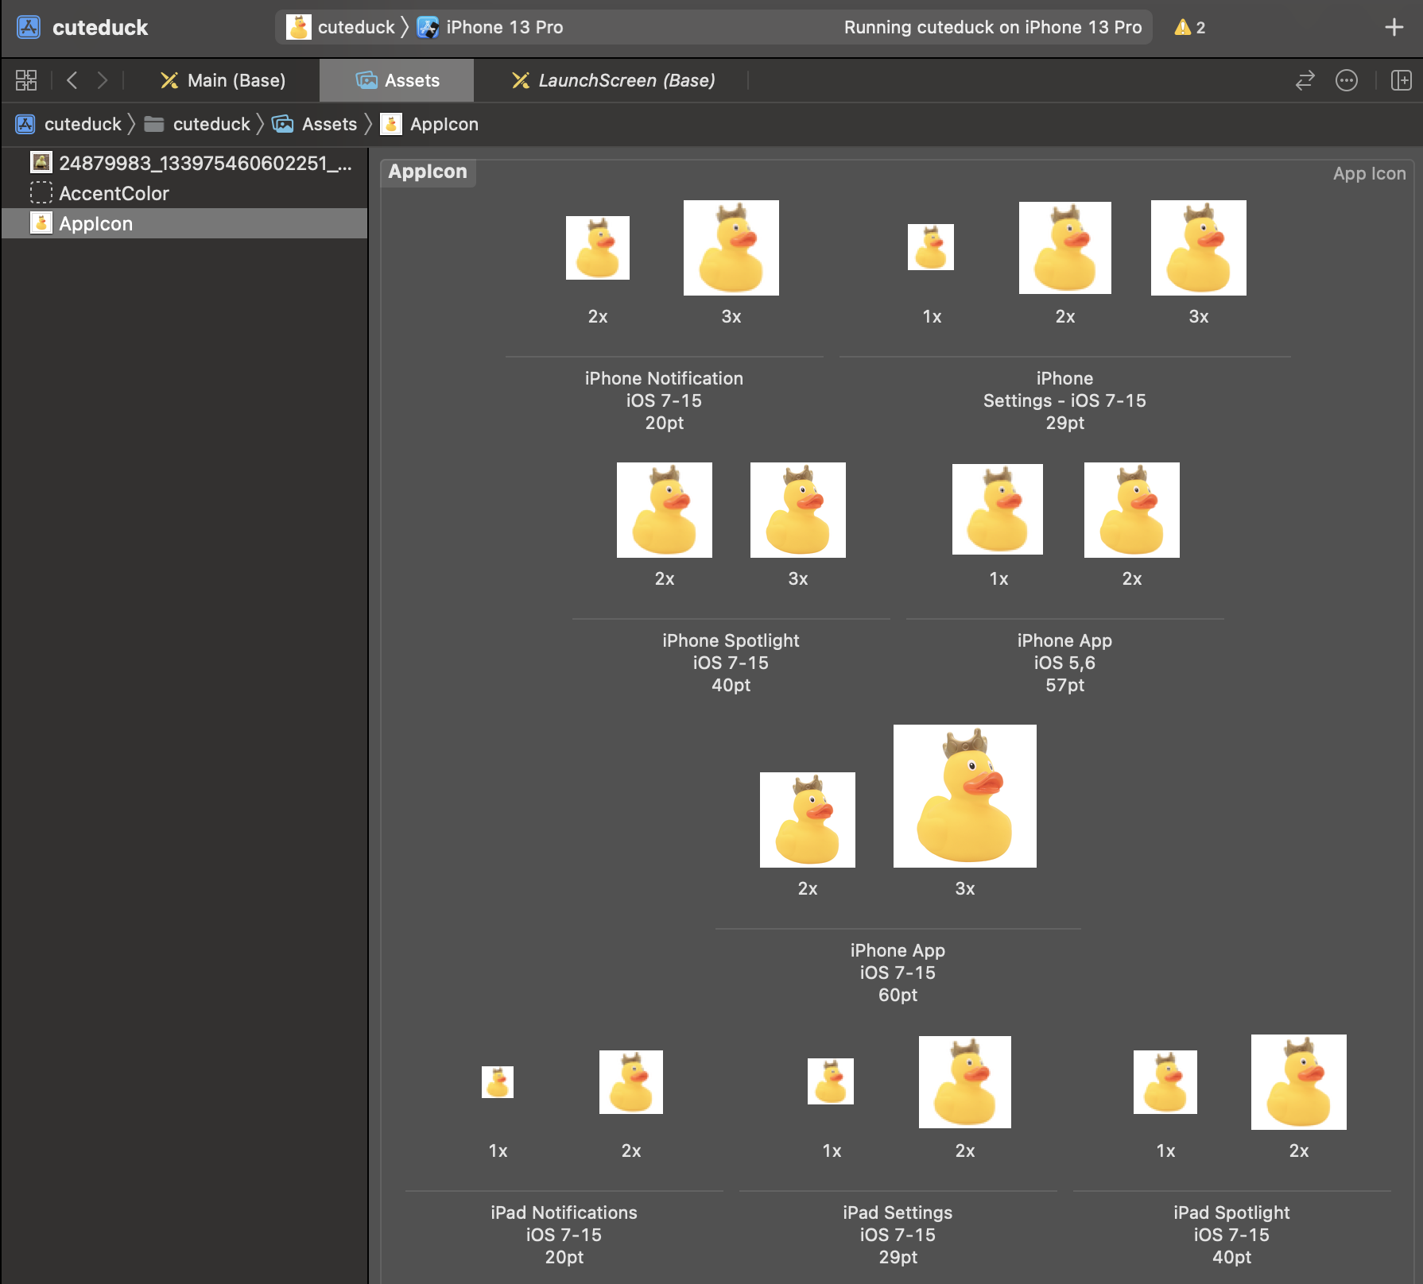
App Icon
1.Use the icons from Diamond_Assets folder we have download previously or use the App Icon Generator(appicon.co) to generate the suitable App Icon.
2.Drop the icons into the Assets => Appicon

Slide 21
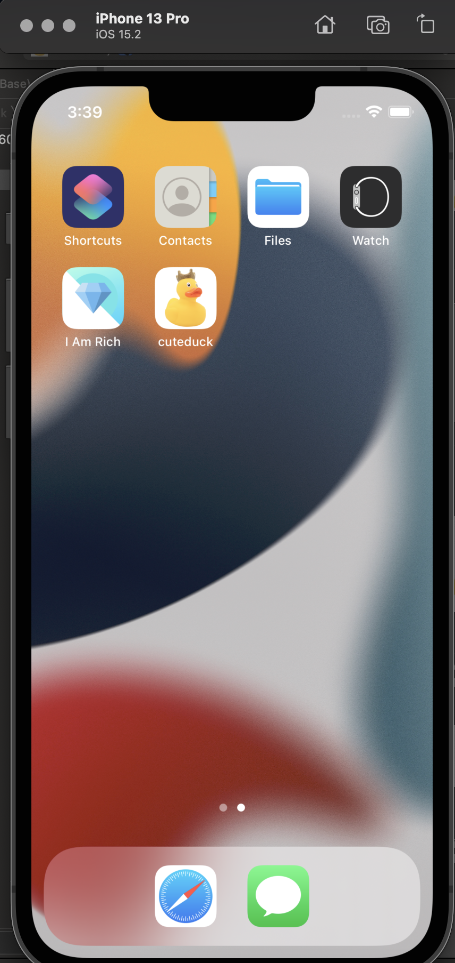
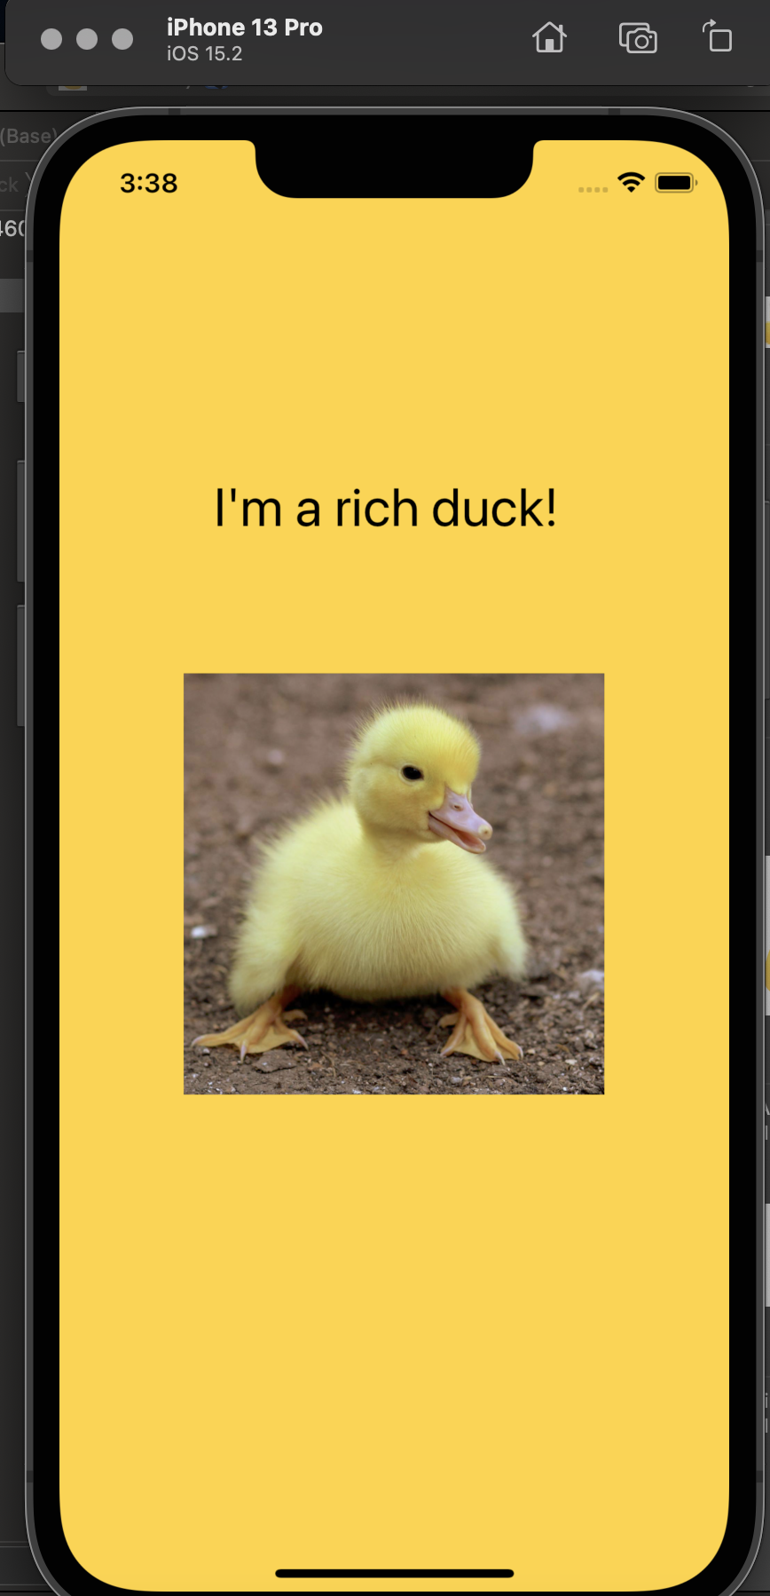
Run Your App

Slide 22

Next week we’ll learn the Swift programming basics

Slide 23

If you are outstanding, you can clone the flappy bird project below: https://github.com/fullstackio/FlappySwift And try to modified it.

